Slide 1
Inferential Wasserstein Generative Adversarial Networks
Mar 15, 2022
Gwangwoo Kim

Slide 2
Contents
1. Introduction
2. Review: WGAN, WGAN-GP
3. iWGAN
4. The Algorithm
5. Probabilistic Interpretation and the MLE
6. Experimental Results
7. References

Slide 3
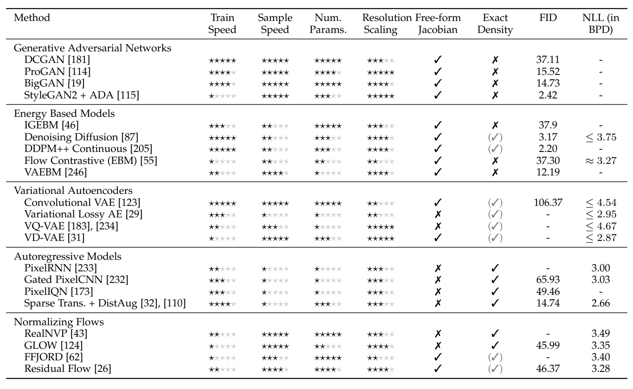
1. Introduction

Slide 4
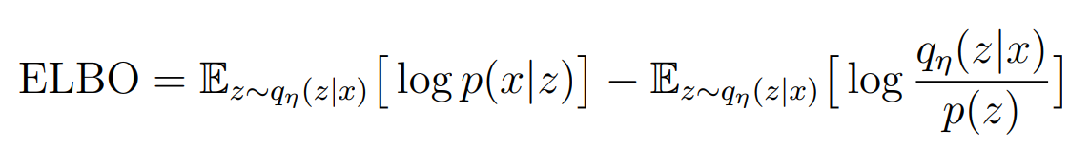
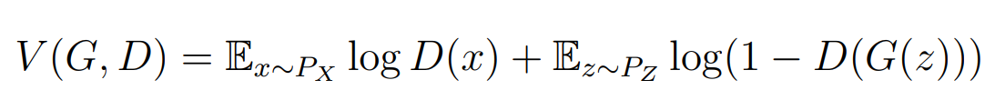
1. Introduction
 | Loss | pros | cons
VAE |  | stability Latent modeling Probabilistic approach | Blurry generation No communication between E and D
GAN |  | Good generation No specific assumptions Arithmetic operations | Hard to learn No criterion for quality and loss

Slide 5
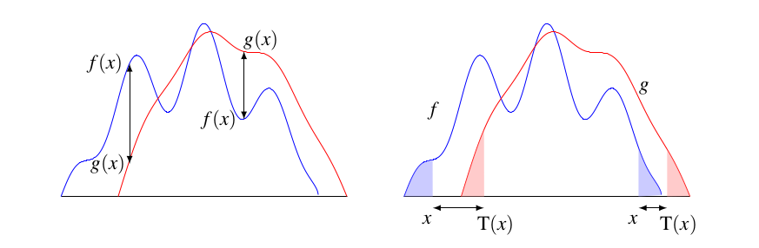
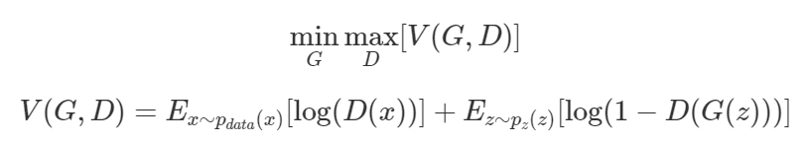
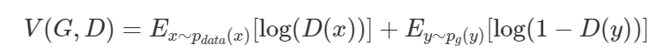
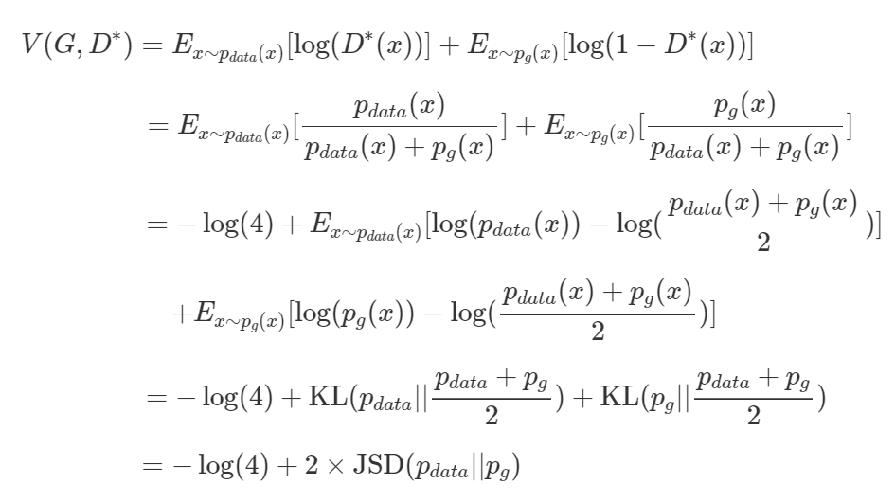
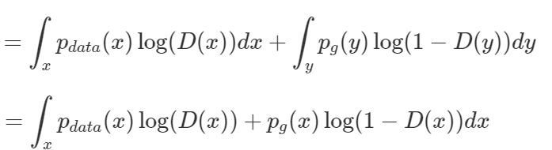
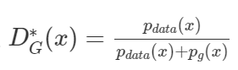
2. WGAN

Slide 6
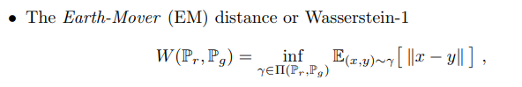
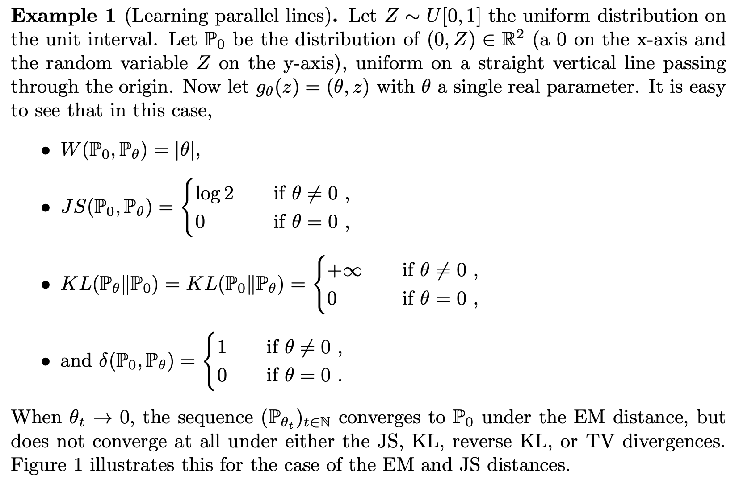
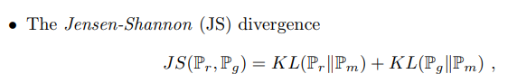
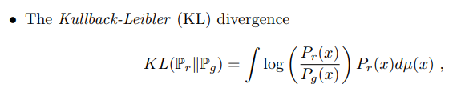
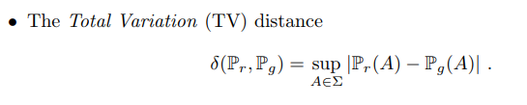
2. WGAN

Slide 7
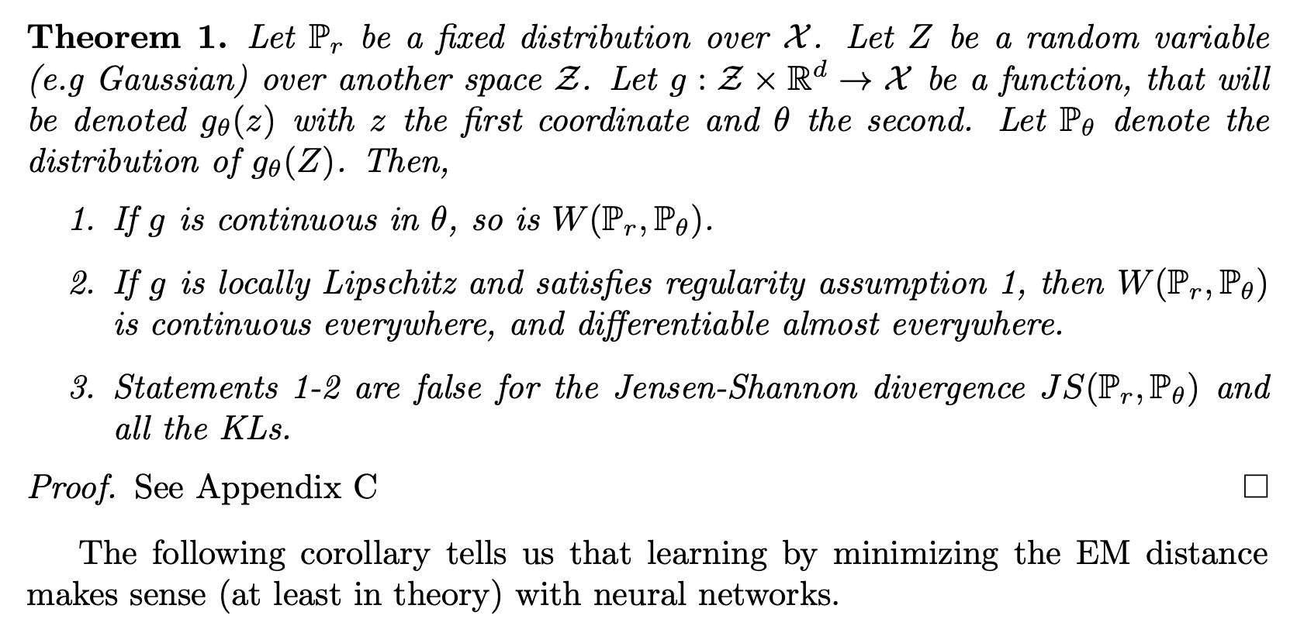
2. WGAN
Can Wasserstein distance be a loss? The answer is probably YES. See the following:

Slide 8
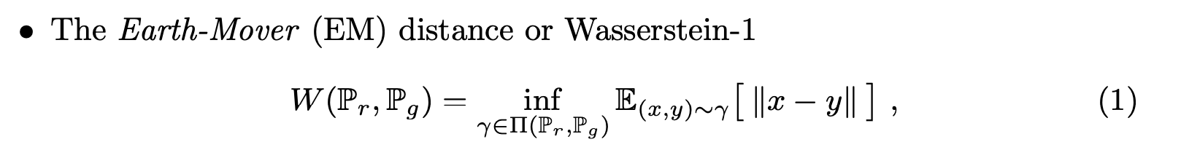
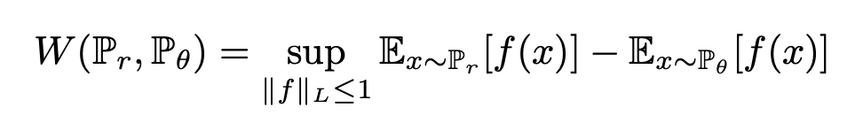
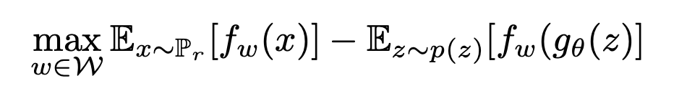
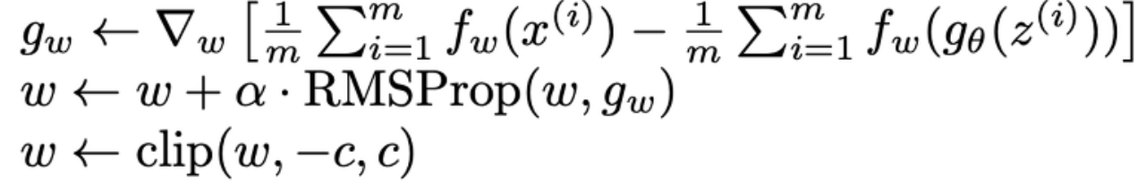
2. WGAN
Kantorovich-Rubinstein duality
and Theorem 1
with parameters
Lipschitz condition but not efficient

Slide 9
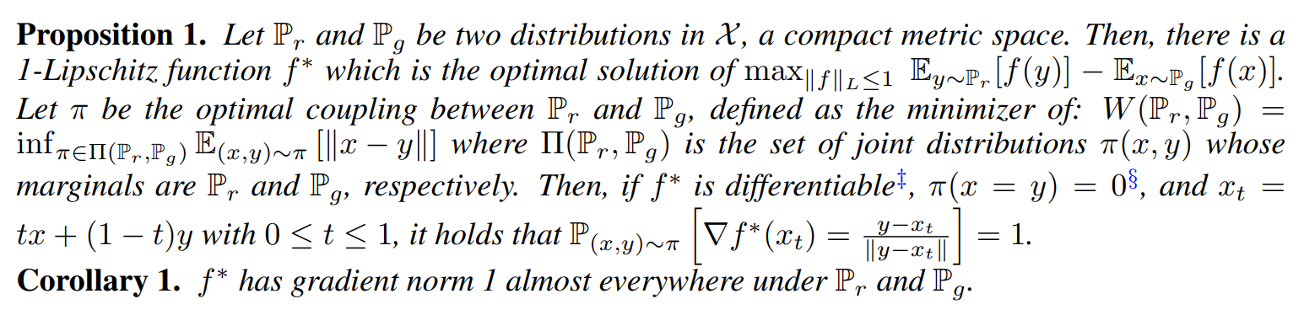
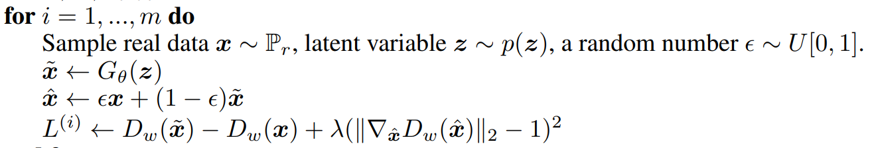
2. WGAN-GP

Slide 10
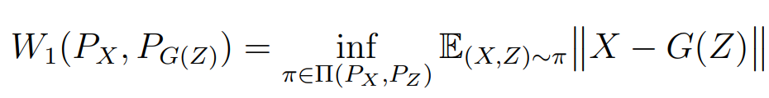
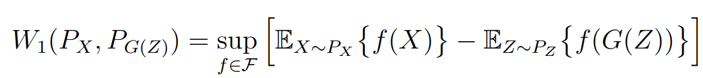
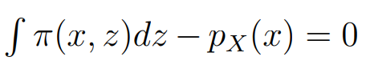
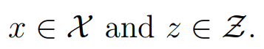
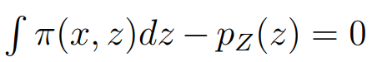
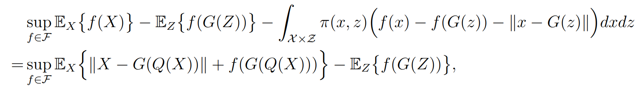
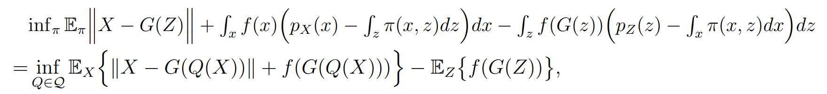
Kantorovich-Rubinstein duality
constraints
constraint
Lagrange Multiplier
Lagrange Multiplier

Slide 11
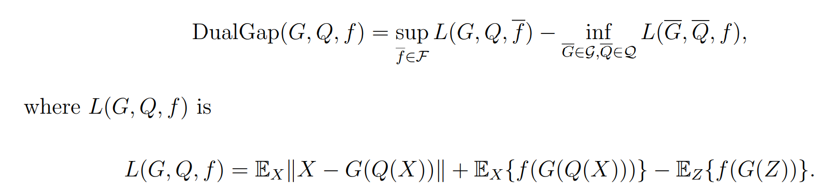
3. iWGAN
Kantorovich-Rubinstein duality
iWGAN (WGAN + WAE)
with stopping criterion

Slide 12
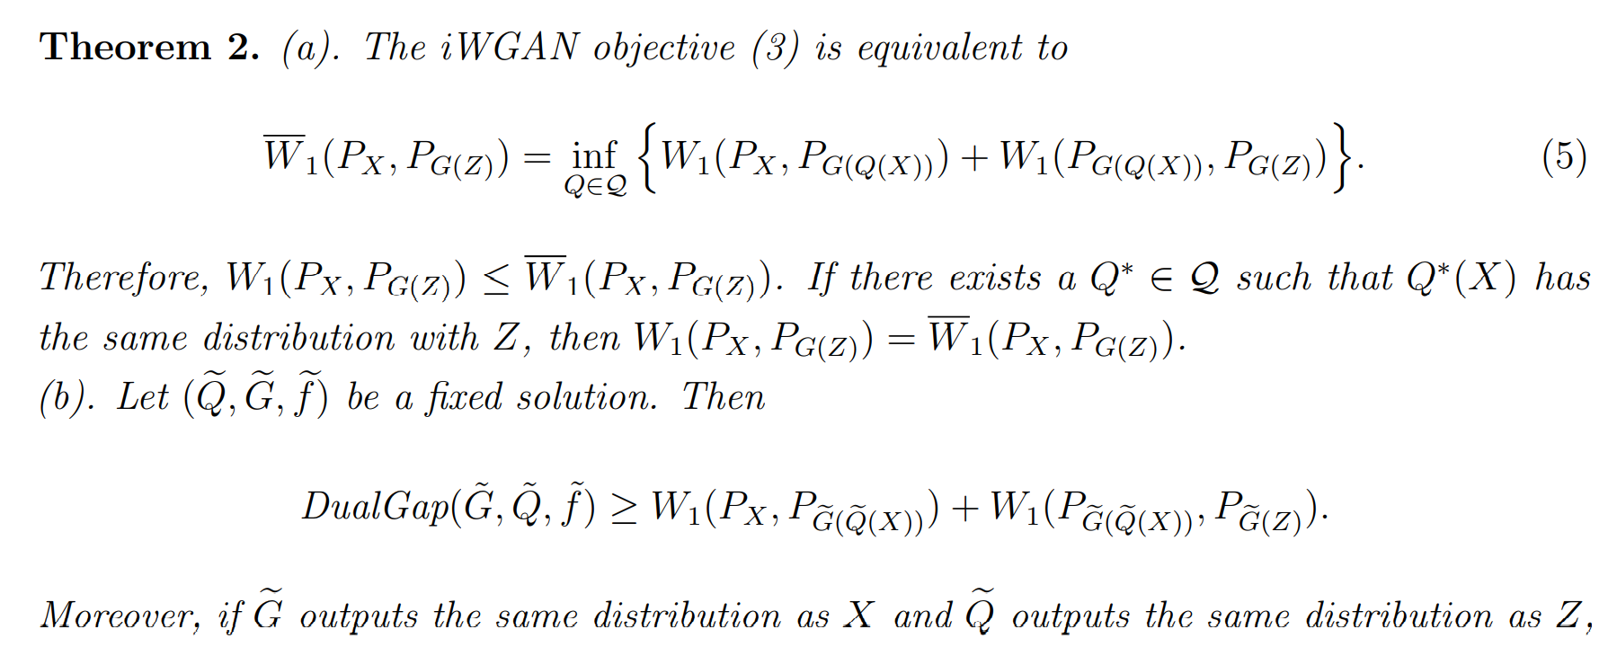
3. iWGAN

Slide 13
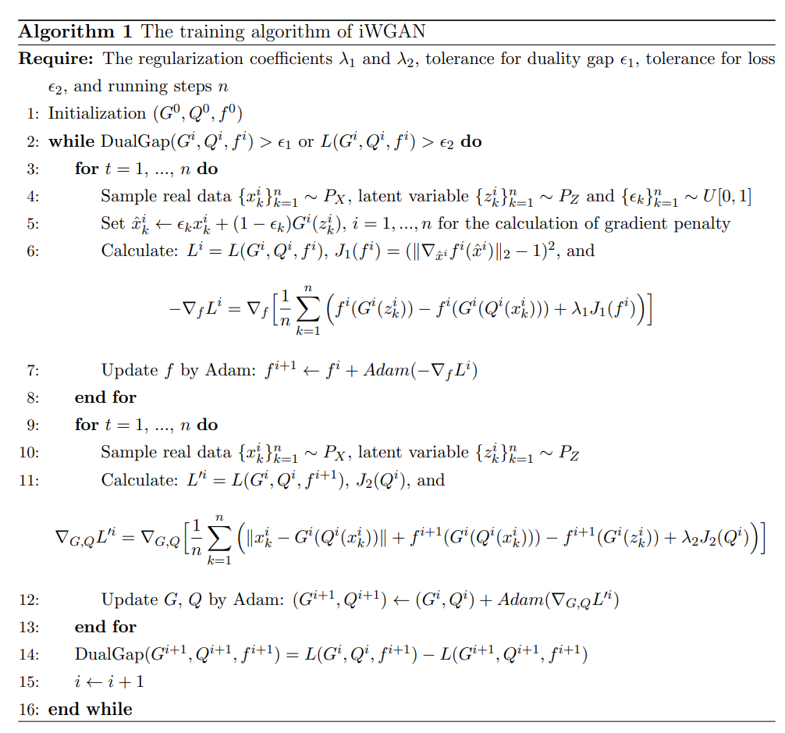
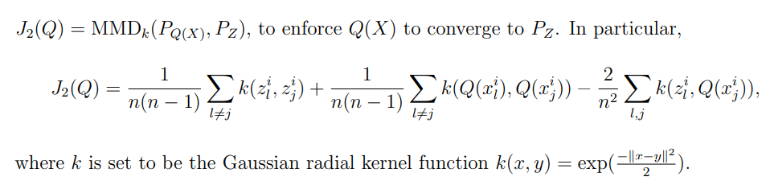
4. The Algorithm

Slide 14
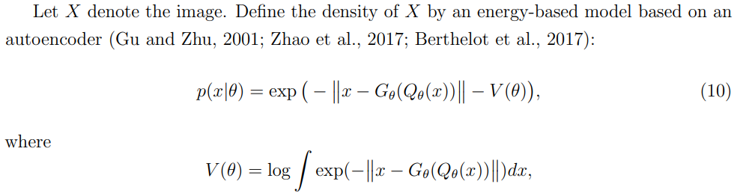
5. Probabilistic Interpretation and the MLE
computational obstacle

Slide 15
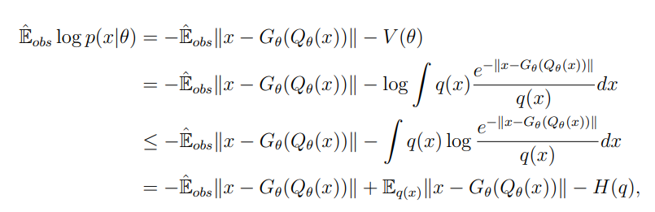
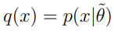
5. Probabilistic Interpretation and the MLE
Upper bound for log-likelihood

Slide 16
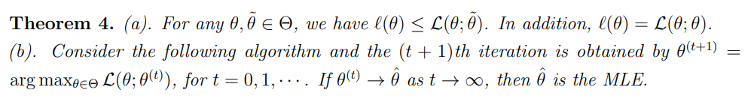
5. Probabilistic Interpretation and the MLE
<Note> The ELBO is in general not a tight lower bound of the log-likelihood function.

Slide 17
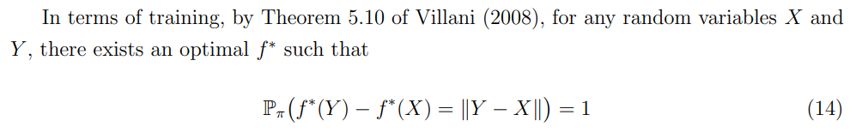
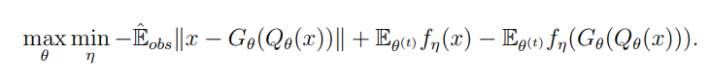
5. Probabilistic Interpretation and the MLE
Cf.

Slide 18
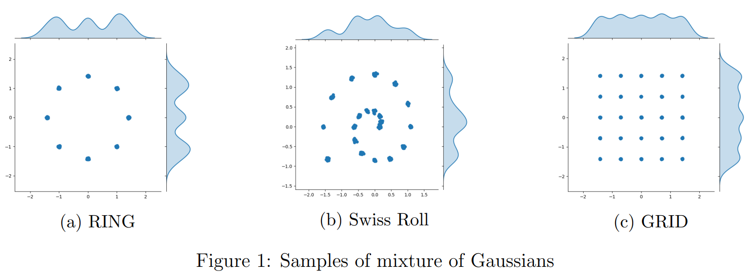
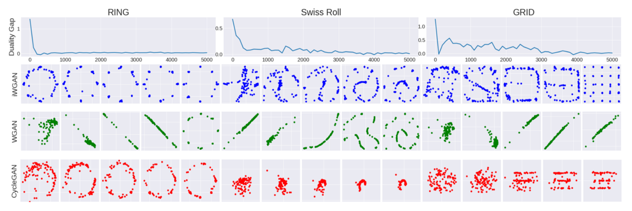
6. Experimental Results

Slide 19
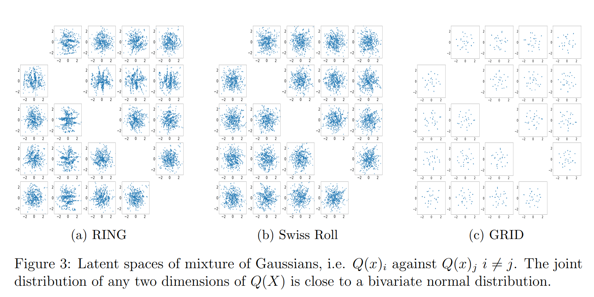
6. Experimental Results

Slide 20
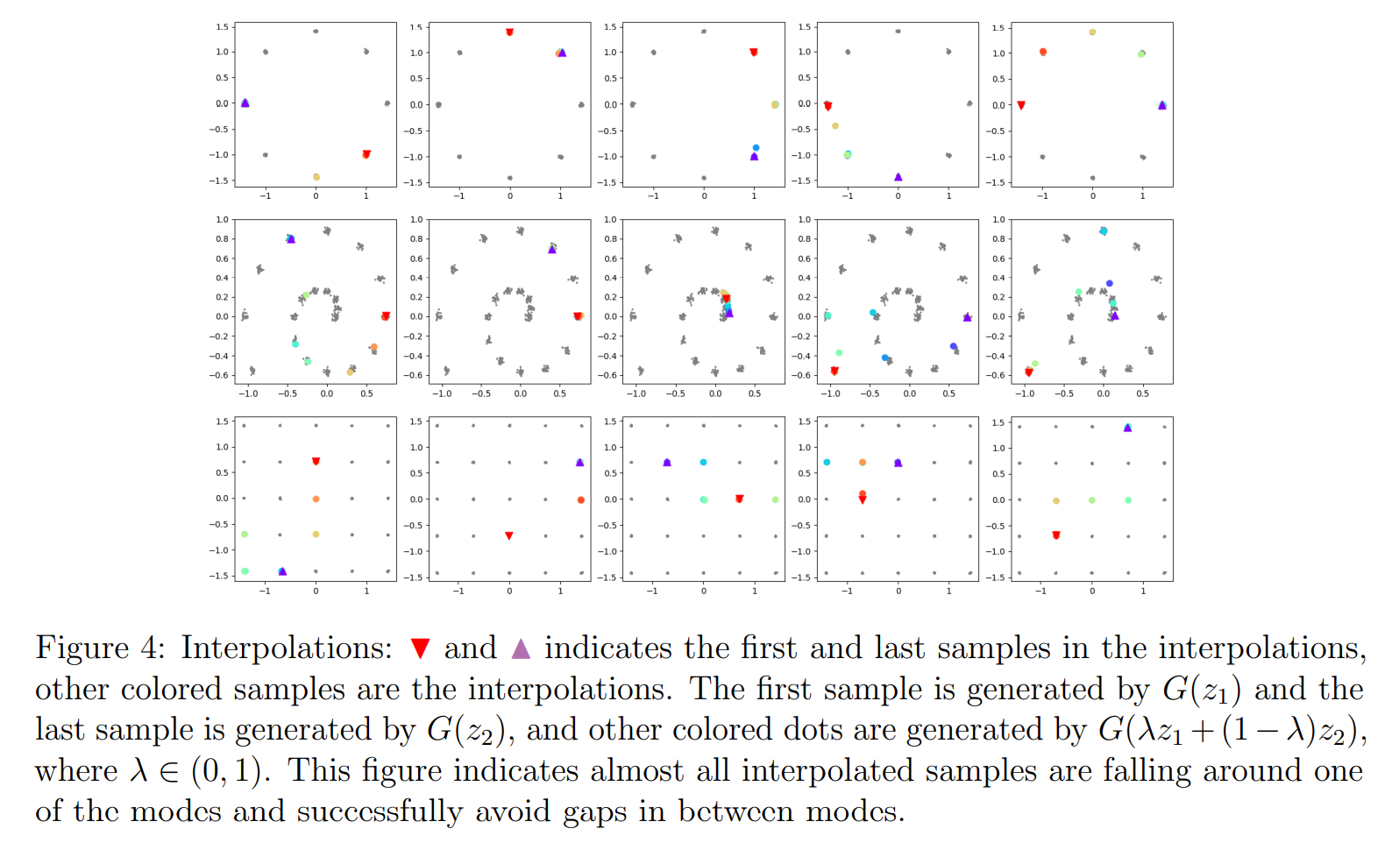
6. Experimental Results

Slide 21
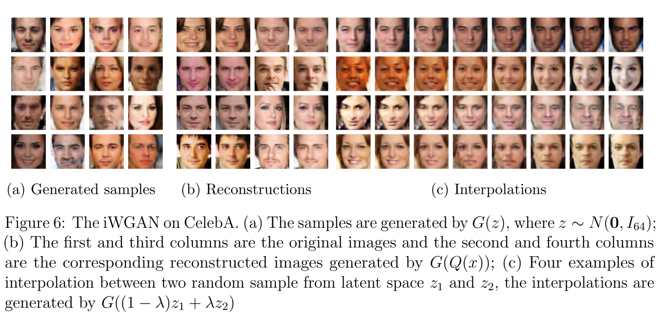
6. Experimental Results

Slide 22
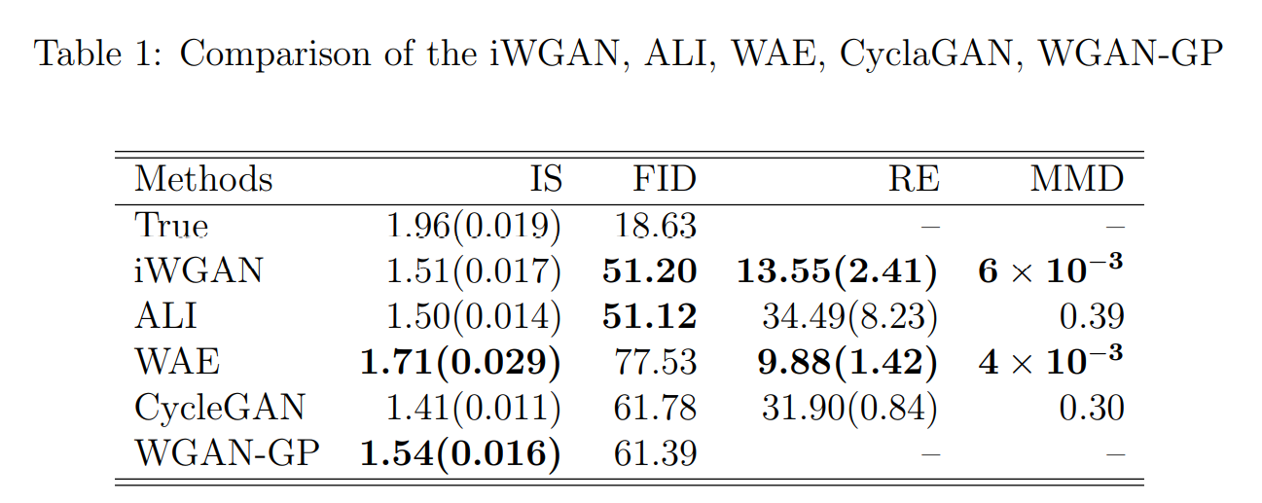
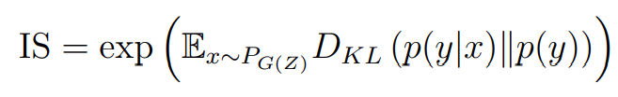
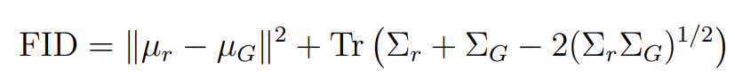
6. Experimental Results
W2 distance between real and fake distributions with
normality assumptions
Low-high entropy from quality and diversity

Slide 23
7. References
[1] Bond-Taylor, S., Leach, A., Long, Y., & Willcocks, C. G. (2021). Deep generative modelling: A comparative review of vaes, gans, normalizing flows, energy-based and autoregressive models. arXiv preprint arXiv:2103.04922.
[2] Chen, Y., Gao, Q., & Wang, X. (2021). Inferential Wasserstein Generative Adversarial Networks. arXiv preprint arXiv:2109.05652.
[3] Arjovsky, M., Chintala, S., & Bottou, L. (2017, July). Wasserstein generative adversarial networks. In International conference on machine learning (pp. 214-223). PMLR.
[4] Gulrajani, I., Ahmed, F., Arjovsky, M., Dumoulin, V., & Courville, A. C. (2017). Improved training of wasserstein gans. Advances in neural information processing systems, 30.
[5] Gretton, A., Borgwardt, K., Rasch, M. J., Scholkopf, B., & Smola, A. J. (2008). A kernel method for the two-sample problem. arXiv preprint arXiv:0805.2368.
[6] Salimans, T., I. Goodfellow, W. Zaremba, V. Cheung, A. Radford, and X. Chen (2016). Improved techniques for training gans. In Advances in neural information processing systems, pp. 2234–2242.

